Slide 1


SIMILAR NEIGHBORHOODS
Varun Moturi

Slide 2

Overview
Purpose
Procedure
Dataset
Data Exploration
Data Clustering
Analysis
Conclusion

Slide 3

Purpose
GTA welcomes more than 100,000 immigrants every year
Immigrants usually face a challenge when it comes to choosing a neighbourhood which would best suit their need.
Immigrant families tend to rent a room at a random location to get a better understanding of the city before they choose to settle in a neighbourhood.
This can be solved by providing the immigrants with enough knowledge about all the neighbourhoods so they can choose the one that is best suited for them.

Slide 4




Procedure
DATA CLUSTERING
DATASET
EXPLORATION
ANALYSIS

Slide 5

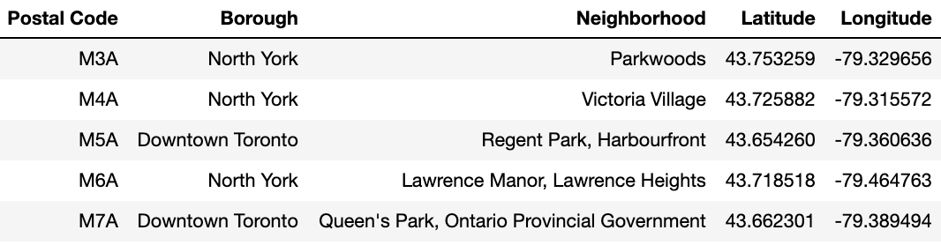
Publicly available dataset on Wikipedia
Dataset contains all the subdivisions of GTA along with its neighbourhoods.
Geocoding API leveraged to obtain the latitude and longitude of each neighbourhood.
DATASET

Slide 6

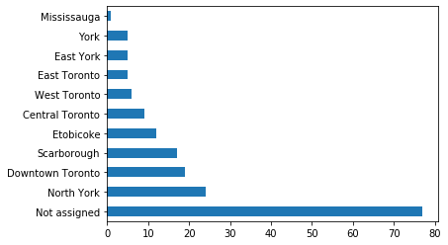
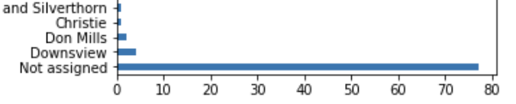
The dataset retrieved a total of 180 postal codes from the online source.
Dataset consisted of many missing values represented as ‘Not Assigned’.
Dropped all the rows where ‘Borough’ was ‘Not Assigned’
Assigned ‘Borough’ as ‘Neighborhood’ if ‘Neighborhood’ was ‘Not Assigned’
Reduced the dataset from 180 rows to 103 rows.
EXPLORATION
Histogram of ‘Borough’ Column
Histogram of ‘Neighborhood’ Column

Slide 7

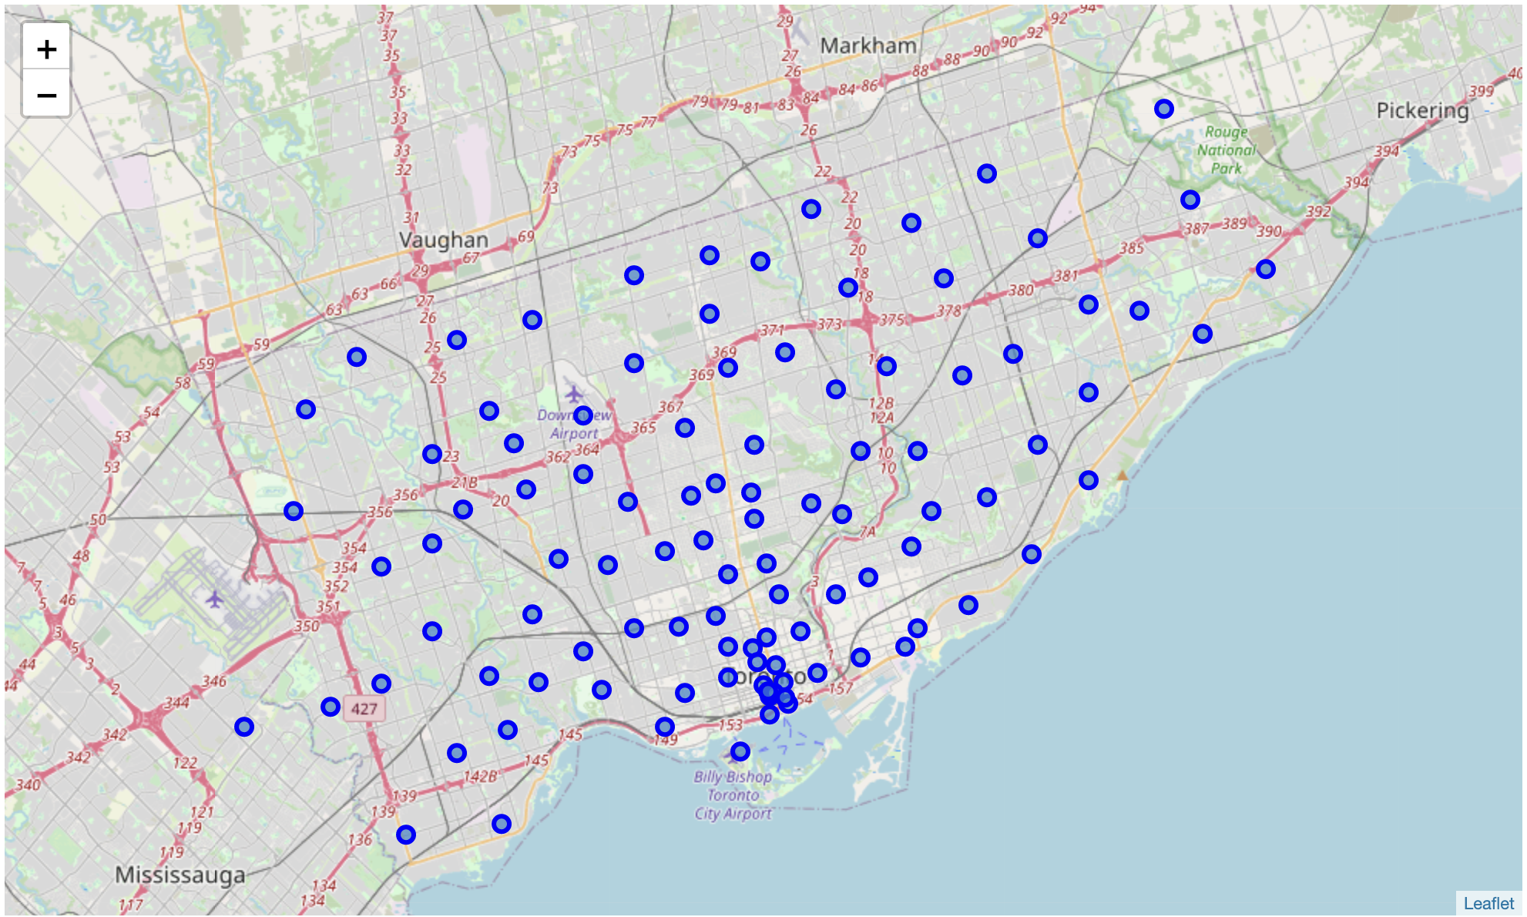
‘follium’ library was used to plot them on a map using longitudes and latitudes
Neighborhoods in the dataset are well dispersed throughout the Greater Toronto Area (GTA)
DATA CLUSTERING

Slide 8
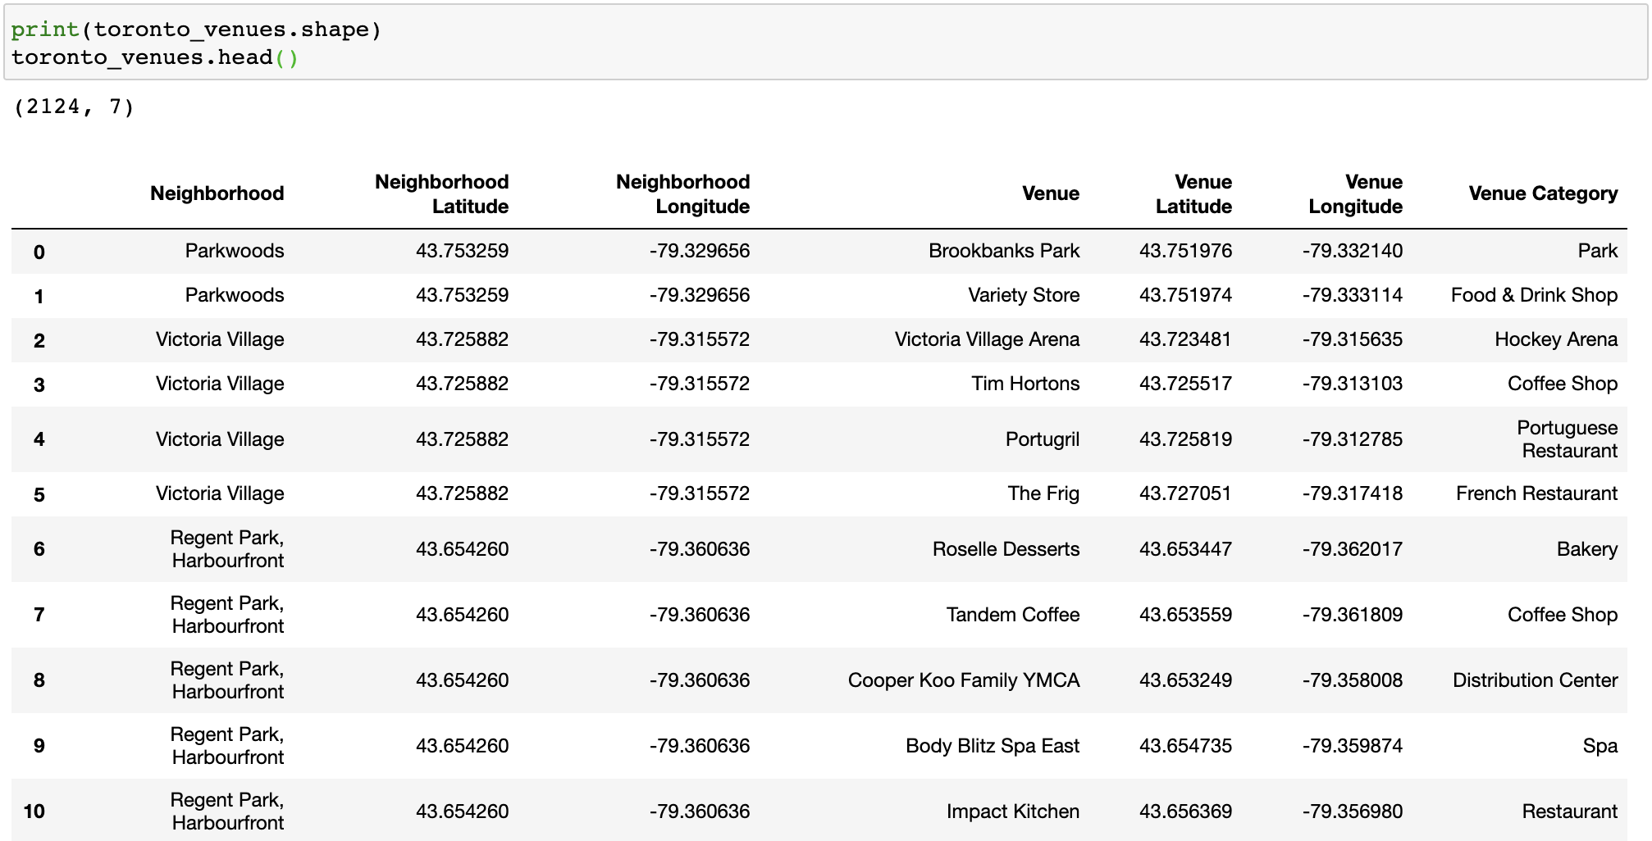
Foursquare API was used to get the points of interest (venues) which are located within 500 m of each neighbourhood.
A total of 271 venue categories and 2124 venues were discovered
DATA CLUSTERING

Slide 9
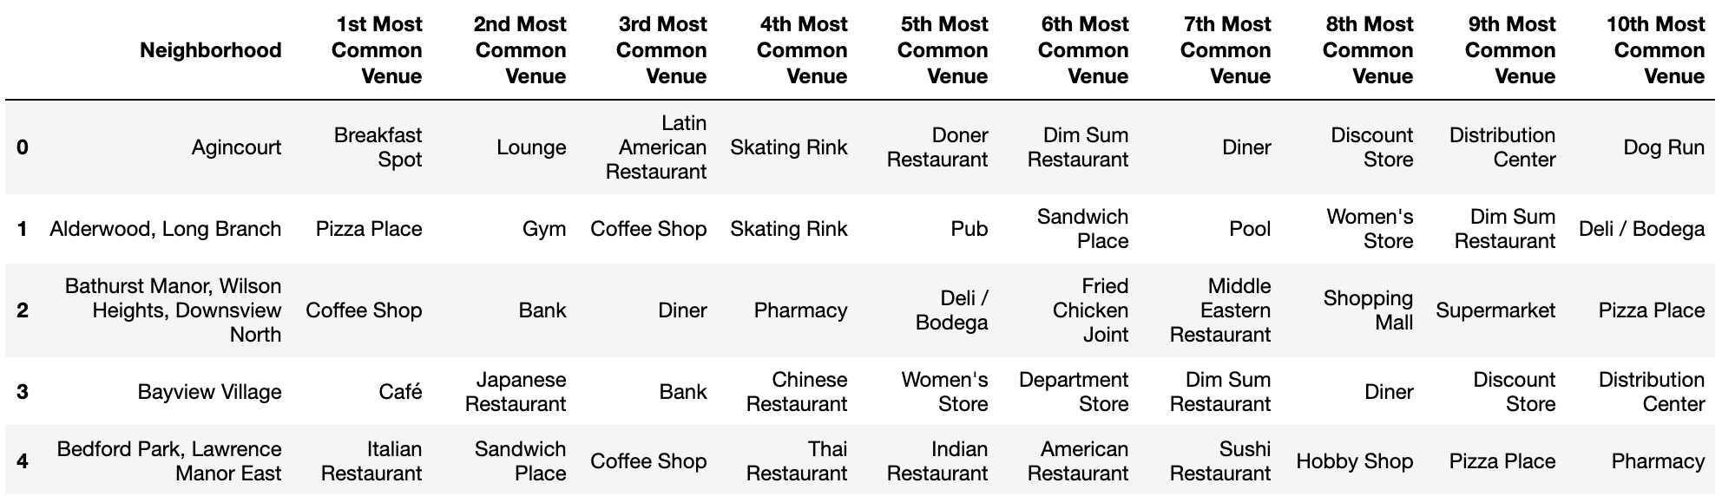
Dataset consisted of categorical variables
‘one-hot encoding’ was performed to convert the categorical data to numerical data
Grouped based the most occurring venue in each neighbourhood
Listed the top 10 most seen venues in each neighbourhood.
DATA CLUSTERING

Slide 10
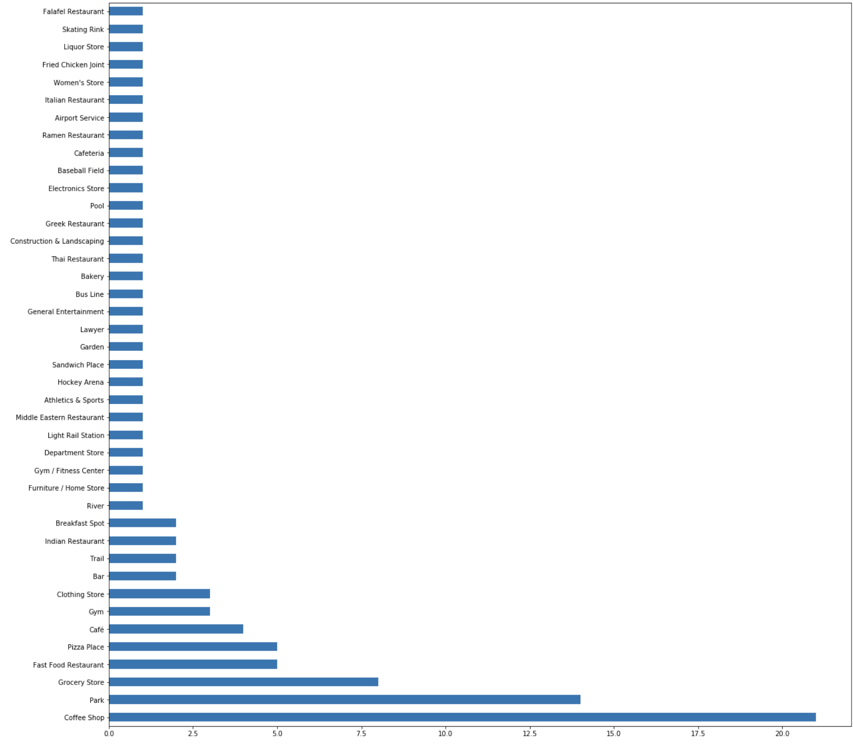
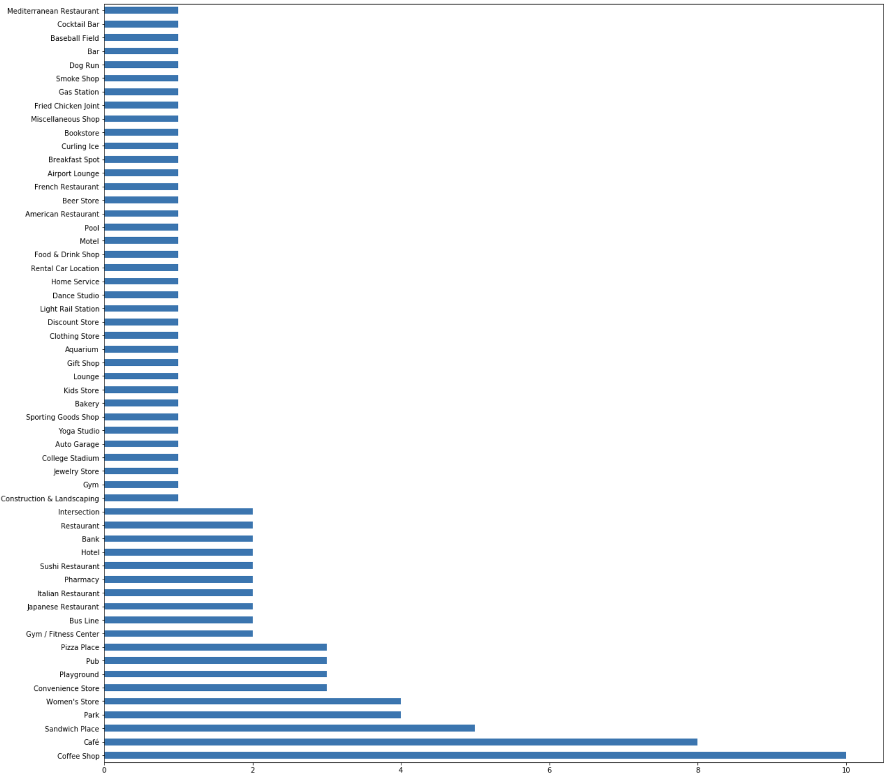
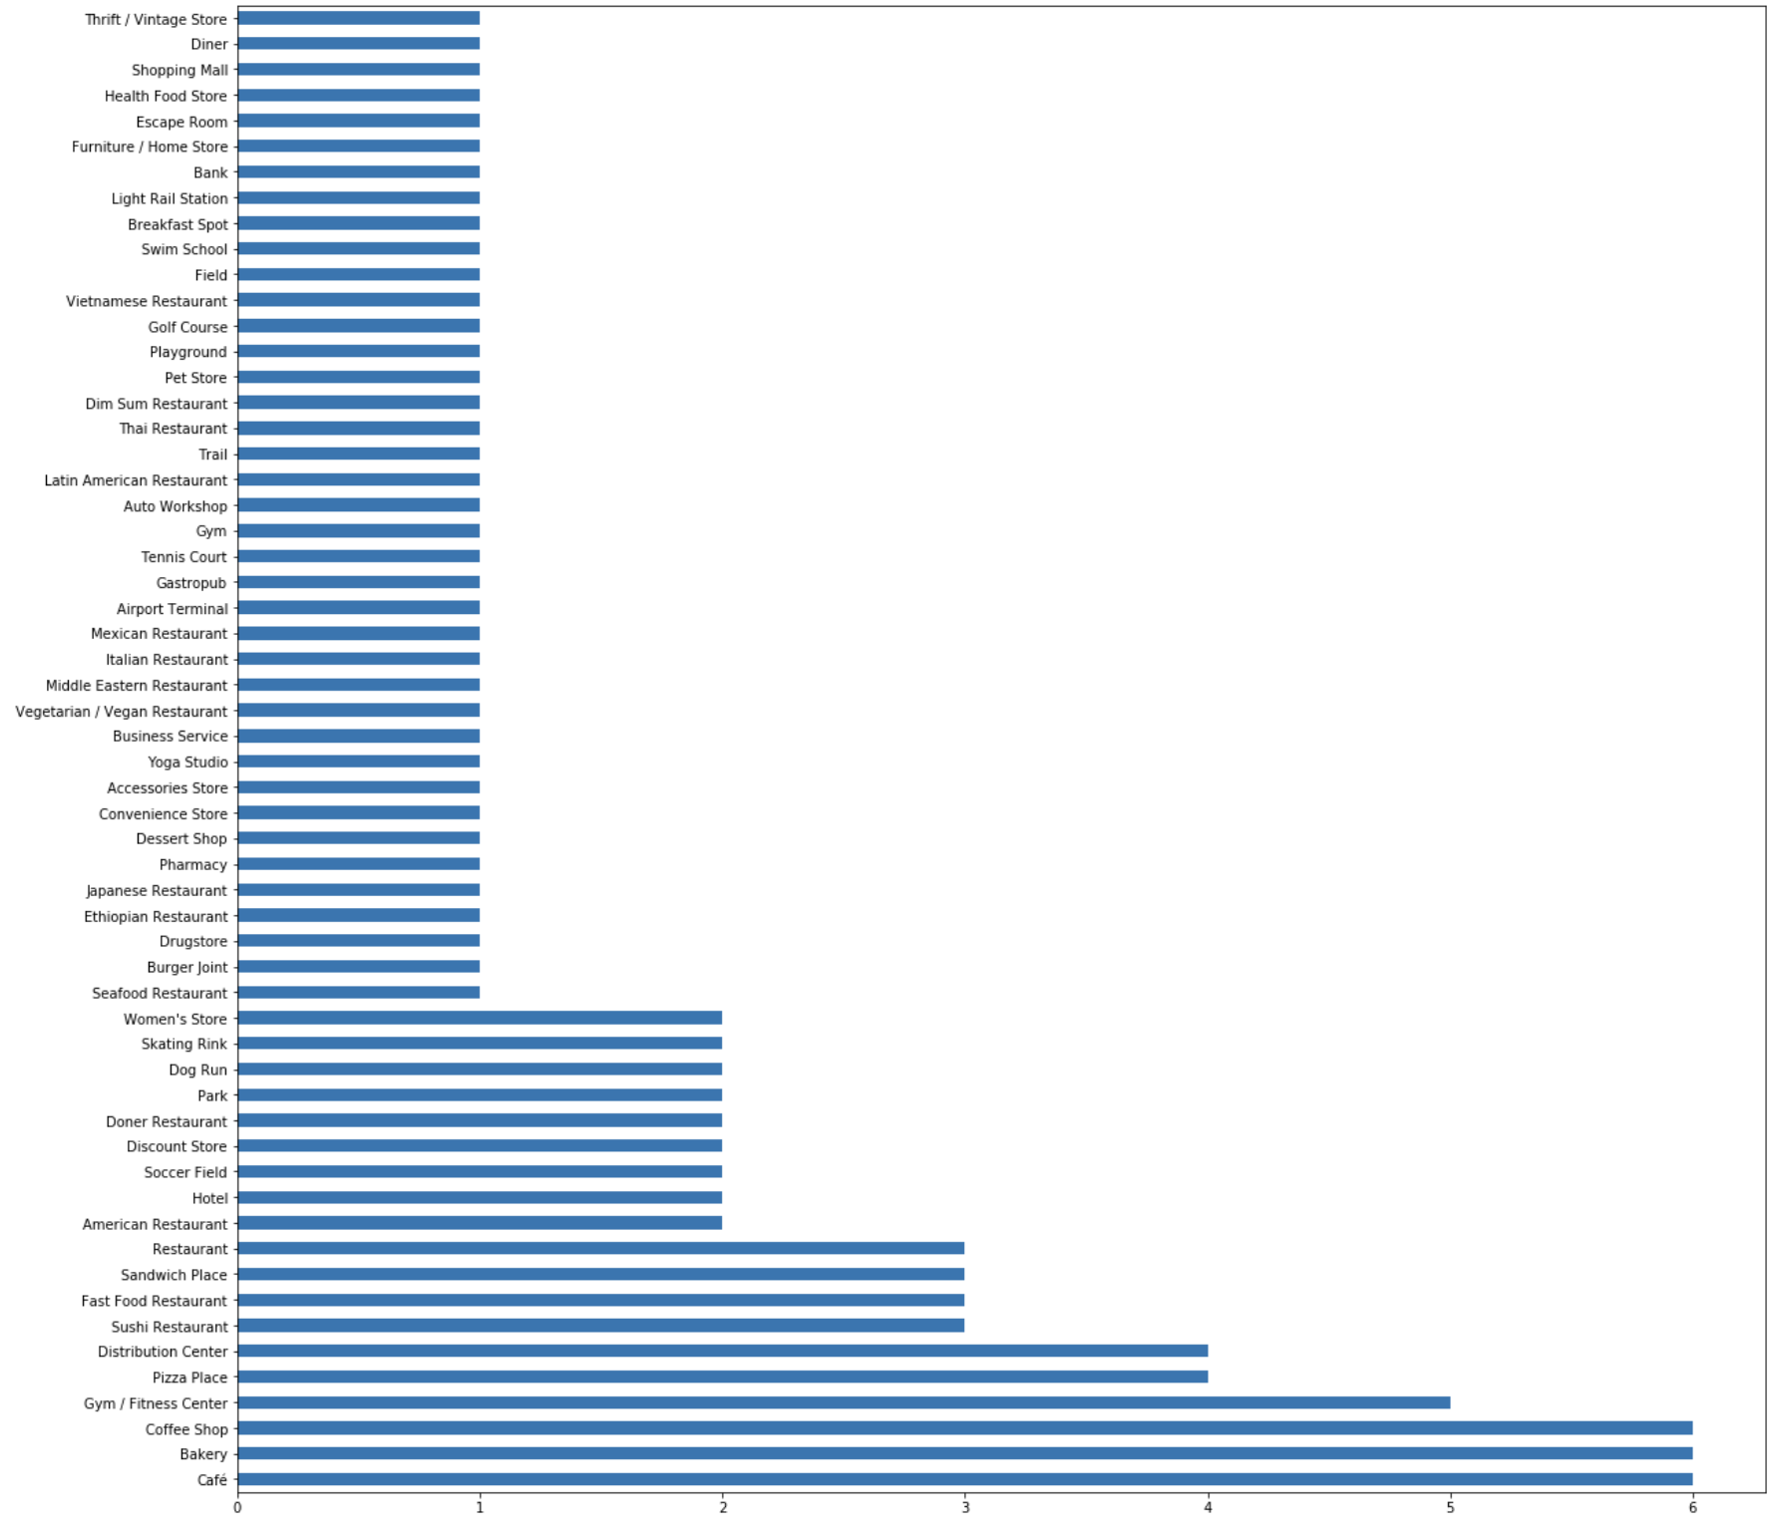
Created histograms of Top 3 venues on all Neighborhoods
‘Coffee shop’ ranked 1st and 2nd among the most common venues followed by ‘Café’,
DATA CLUSTERING

Slide 11
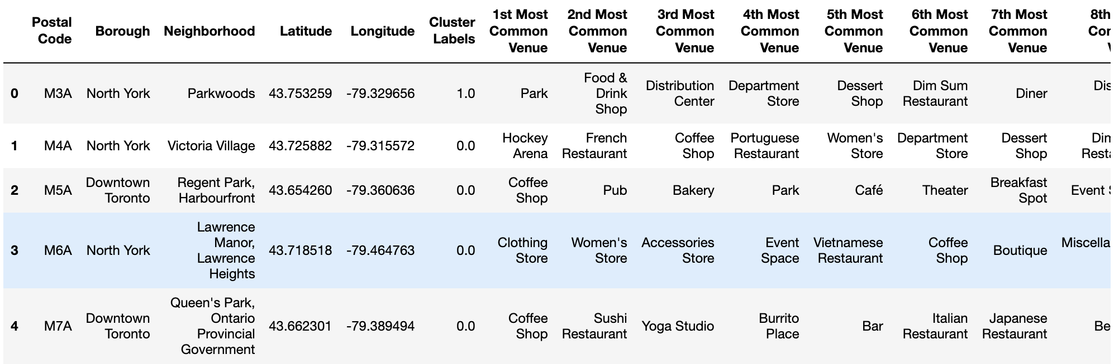
‘k-nearest neighbours’ algorithm was performed to cluster the neighbourhoods based the venues.
Cluster labels were created for each neighbourhood.
DATA CLUSTERING

Slide 12
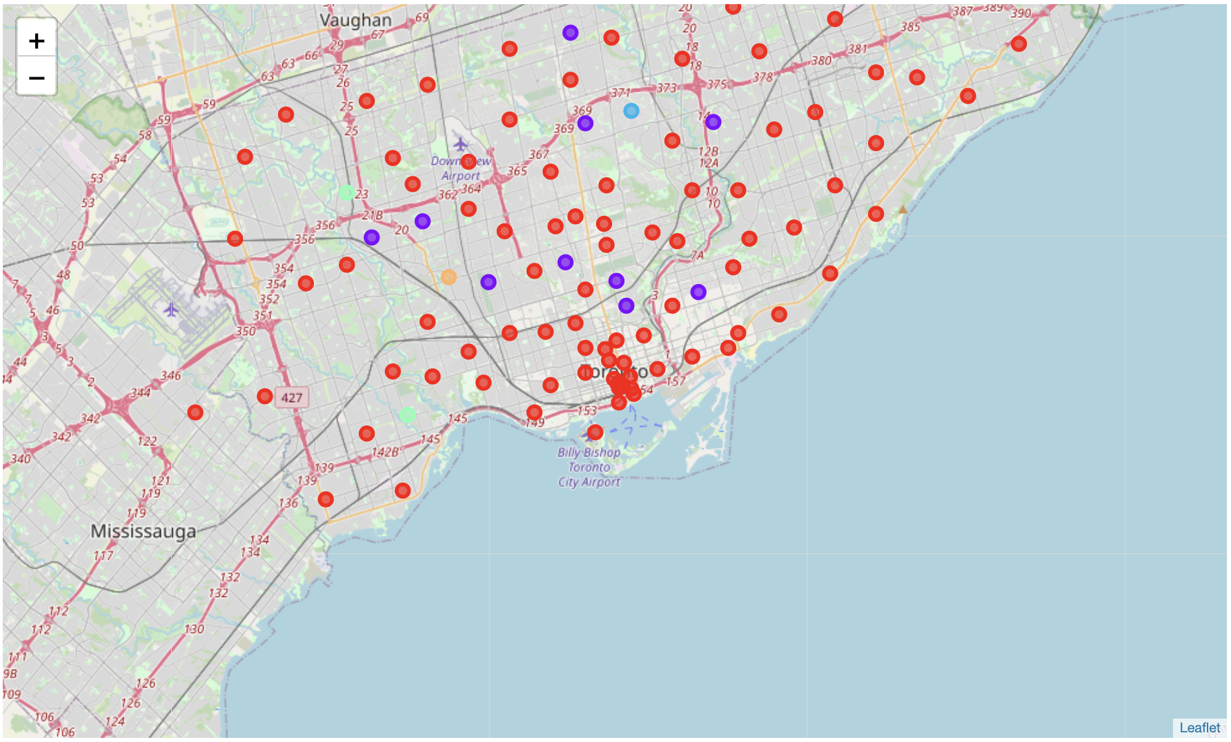
Neighbourhood was plotted again on the map
Color-coded based on the cluster label
Visually representation of all similar neighbourhoods in GTA
DATA CLUSTERING

Slide 13
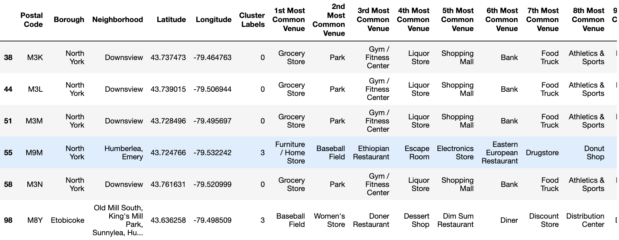

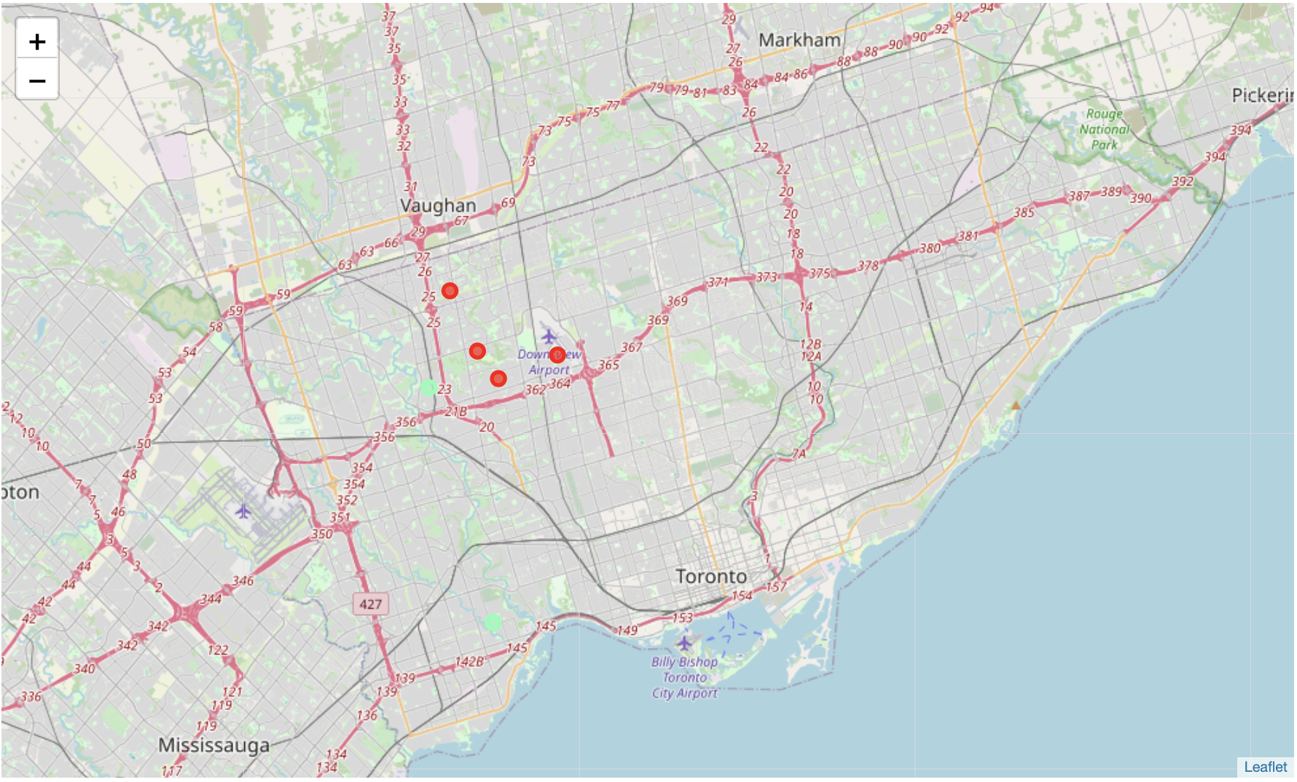
Displaying all neighborhoods with a ‘Baseball Field’
ANALYSIS

Slide 14


Conclusion
Retrieved a Publicly available Dataset
Used Geocoding API to get latitudes and longitudes
Explored and cleaned the data
Visually represented the data on a Map
Created a clustering model using KNN
Tested the model
Immigrant moving to Toronto can enter the amenities and get a list of best suited neighborhoods
Model could be applied to cities other than Toronto

Slide 15
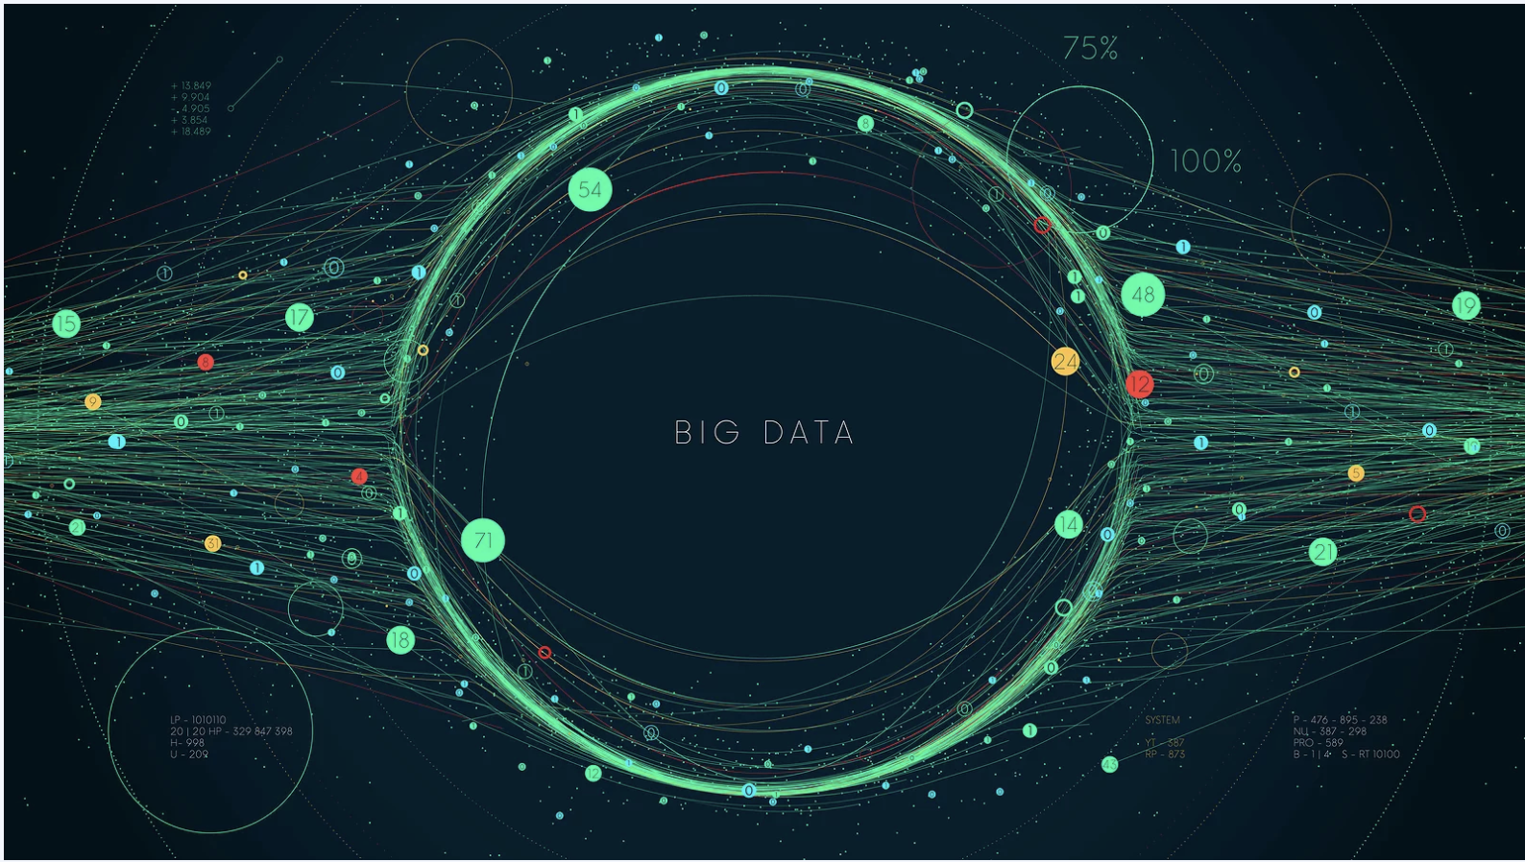
THANK YOU

